Slide 1

Holy Trinity starts
OPAL Play!
12/09/24

Slide 2
Everyone’s responsibility…
At Holy Trinity everyone…
has the right to play.
shares equipment fairly and shows respect to others.
is kind and considers others’ feelings.
plays safely.
helps others and allows everyone to join in.
asks for help from an adult if they need it.

Slide 3
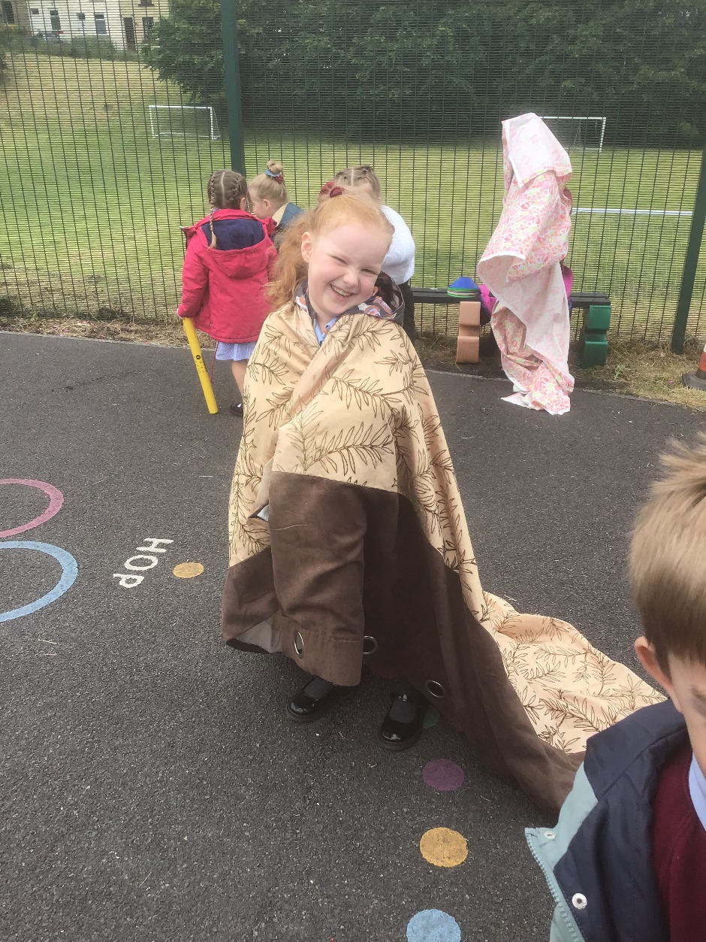
What do we have so far?
Tyres
Pots and Pans
Creative Resources
Dens
Role Play Box
Staging
Chalks
Music!

Slide 4
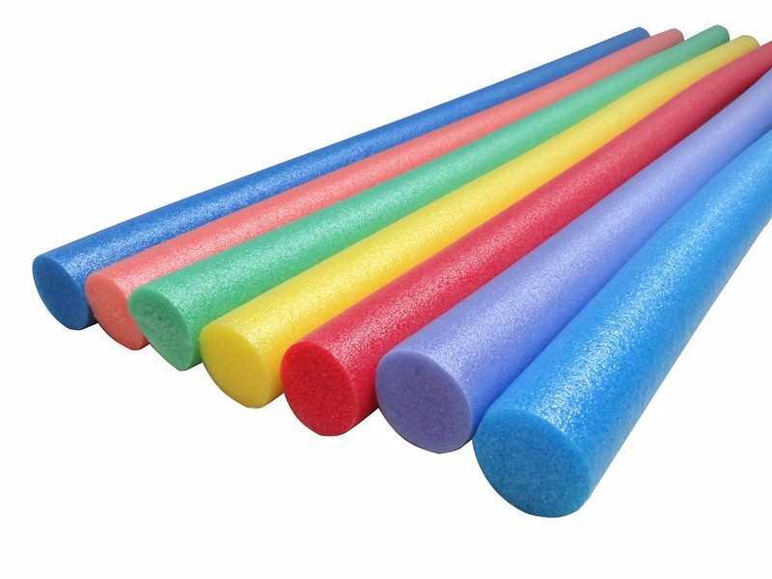
Safe Play
Pool Noodles
Rough Play/Play Fighting
Boomwackers
Zones are open when there is
an adult.
Basket should stay on the grass.
Are you safe enough?

Slide 5
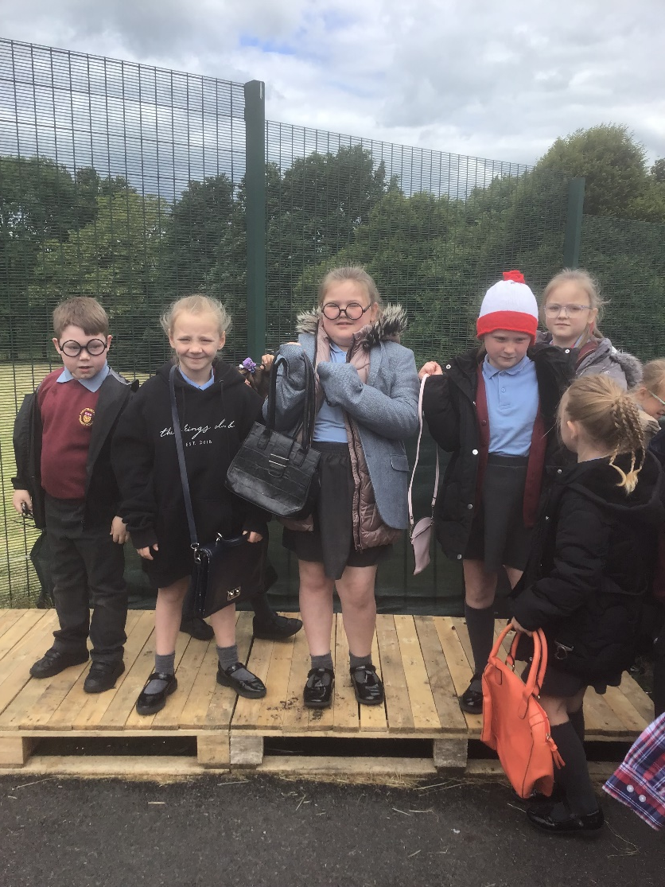
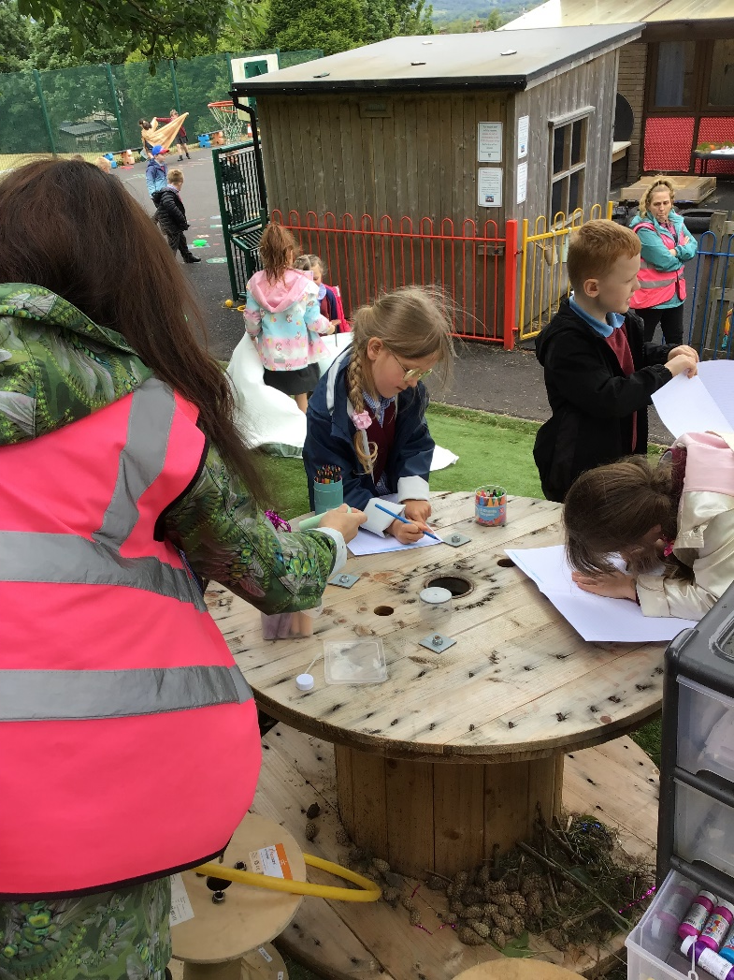
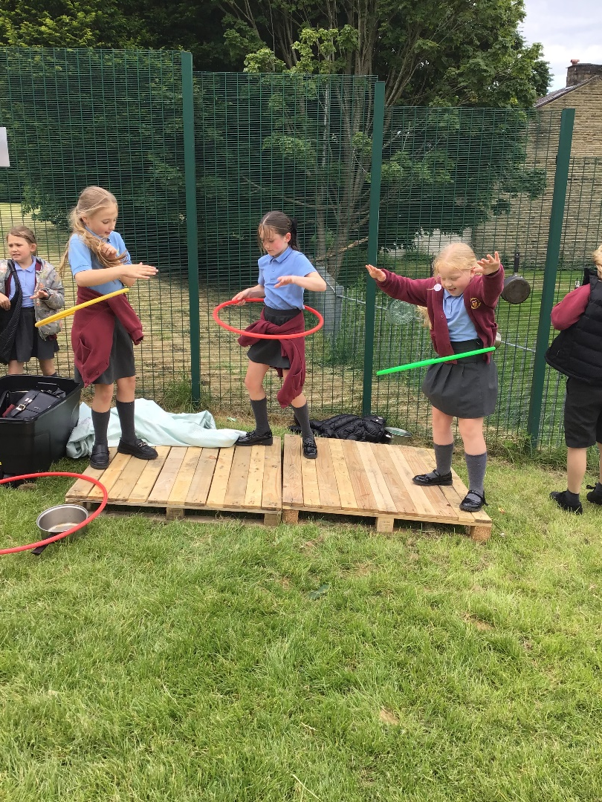
Some Amazing Play!

Slide 6
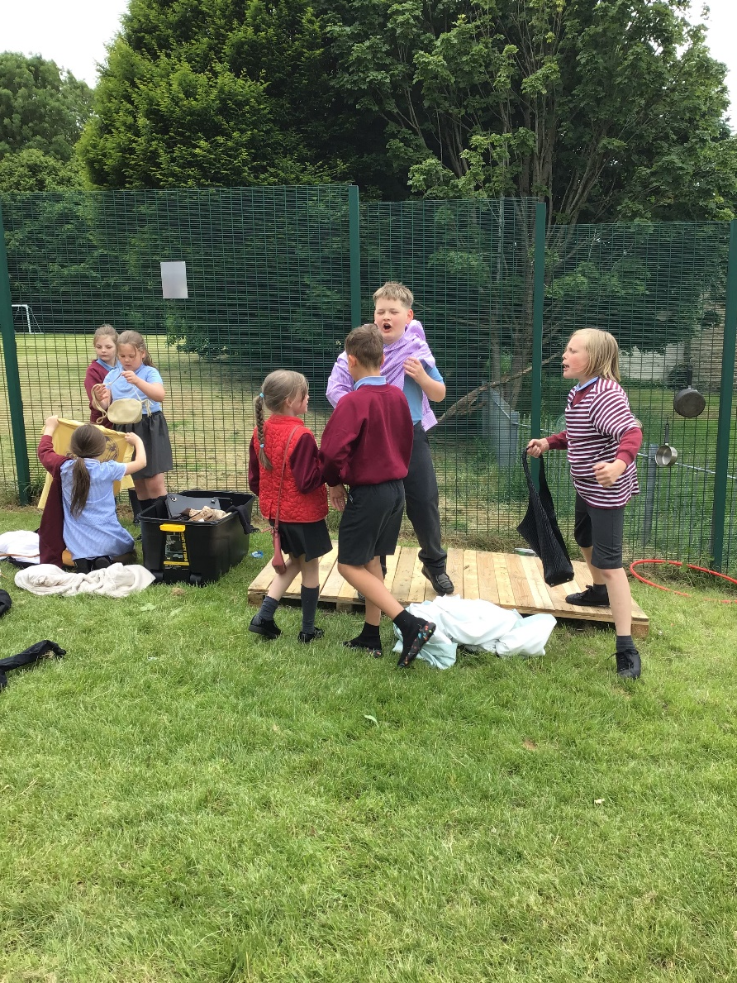
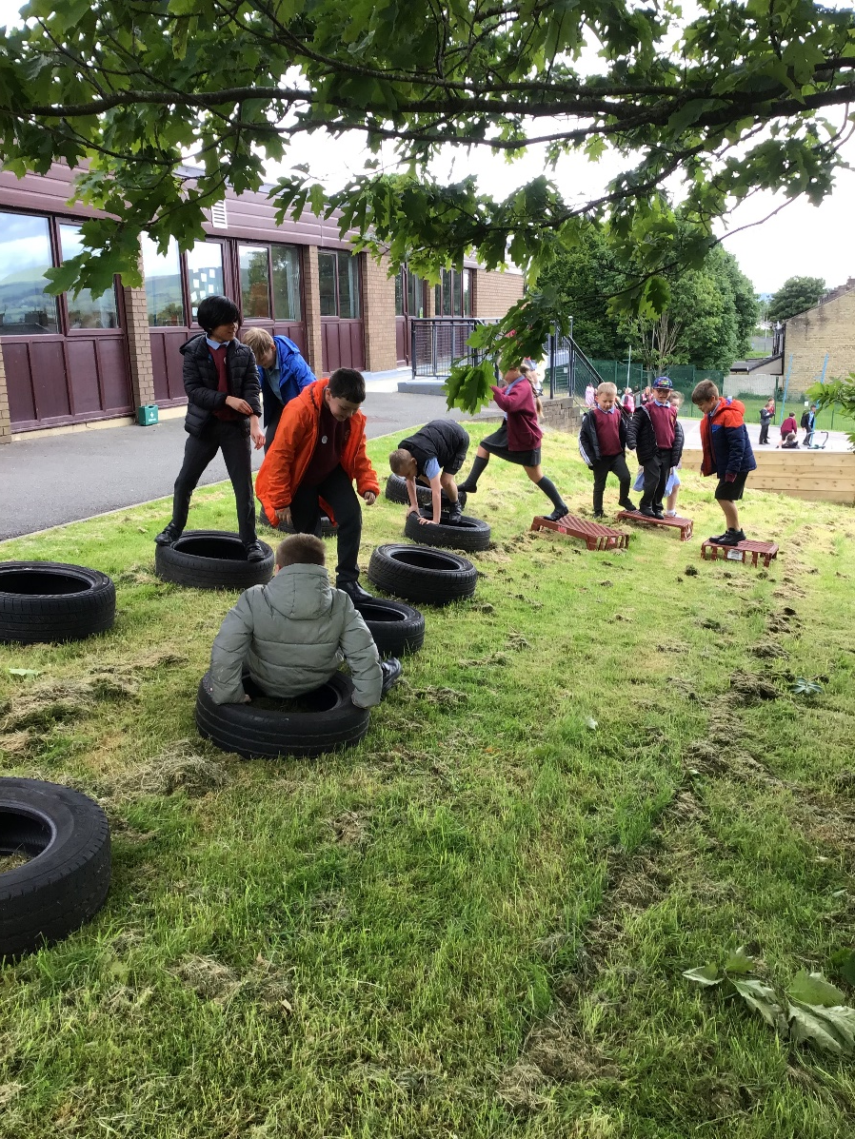
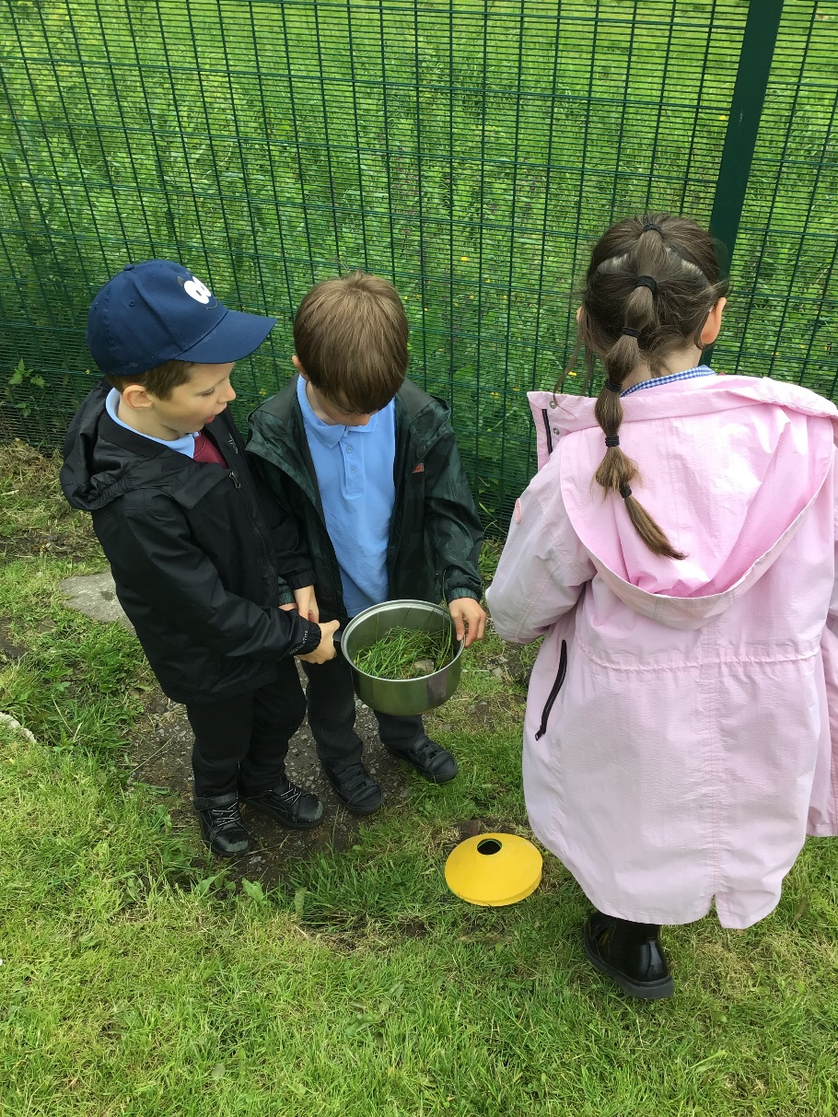

Slide 7
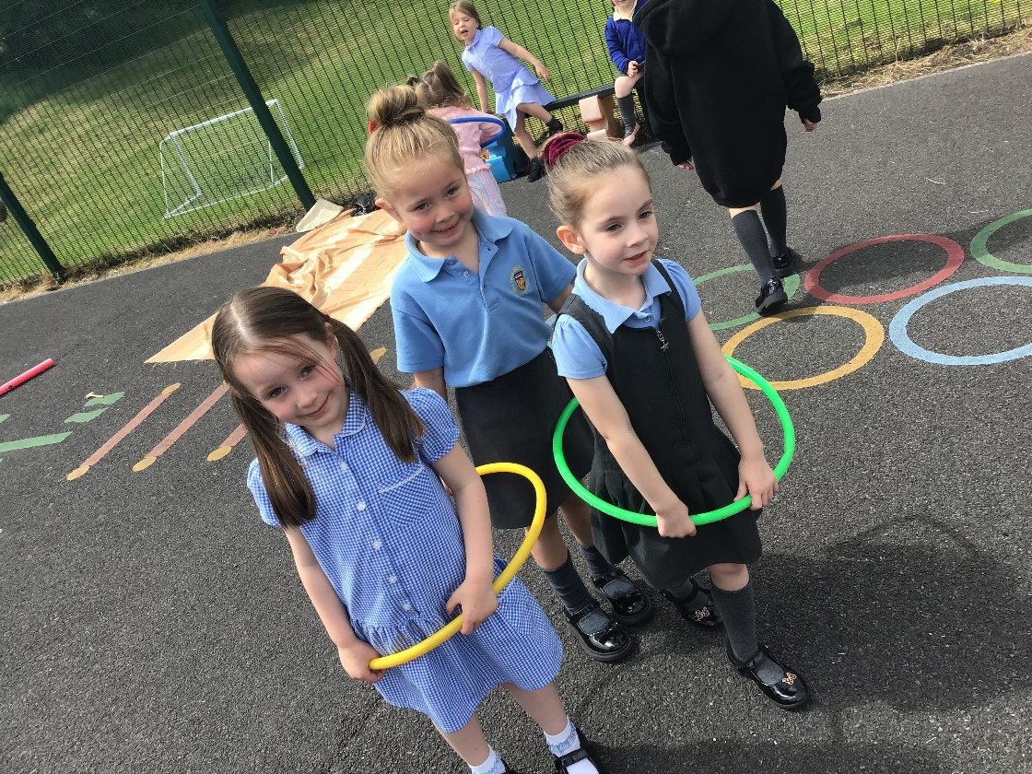
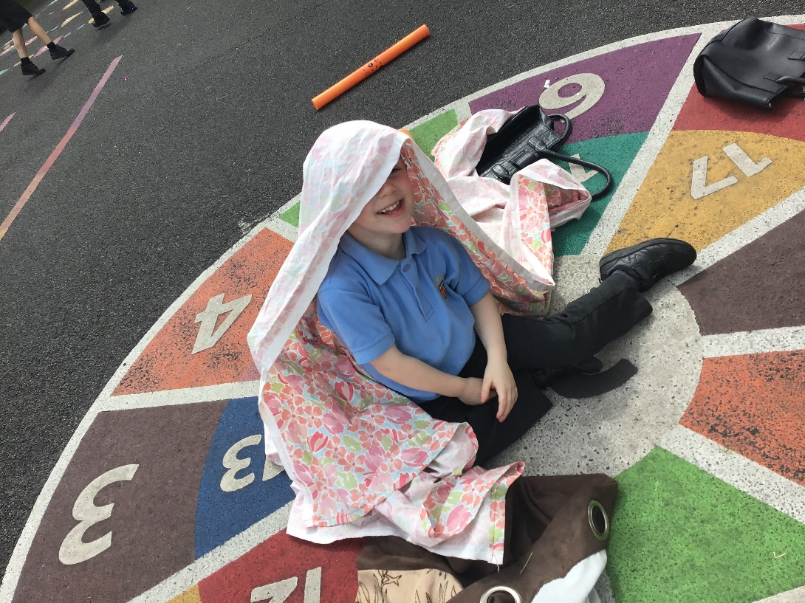
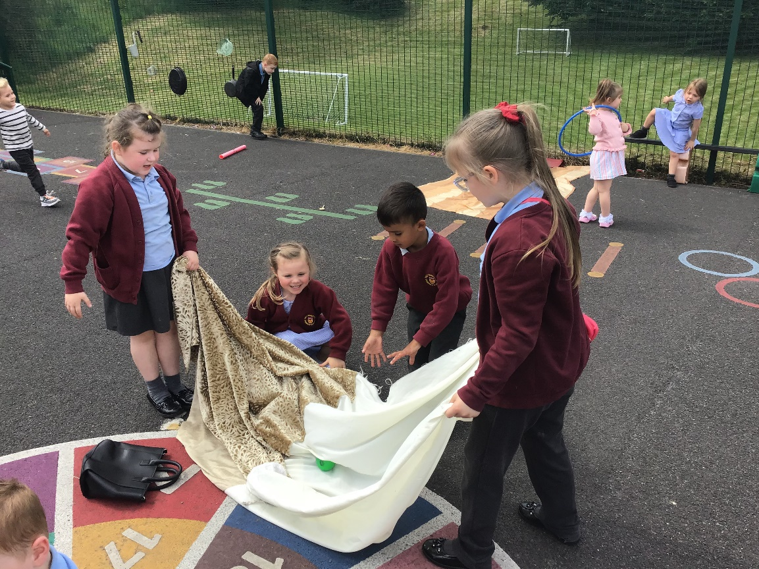

Slide 8


