Slide 1

Holy Trinity starts
OPAL Play!
20/06/24

Slide 2
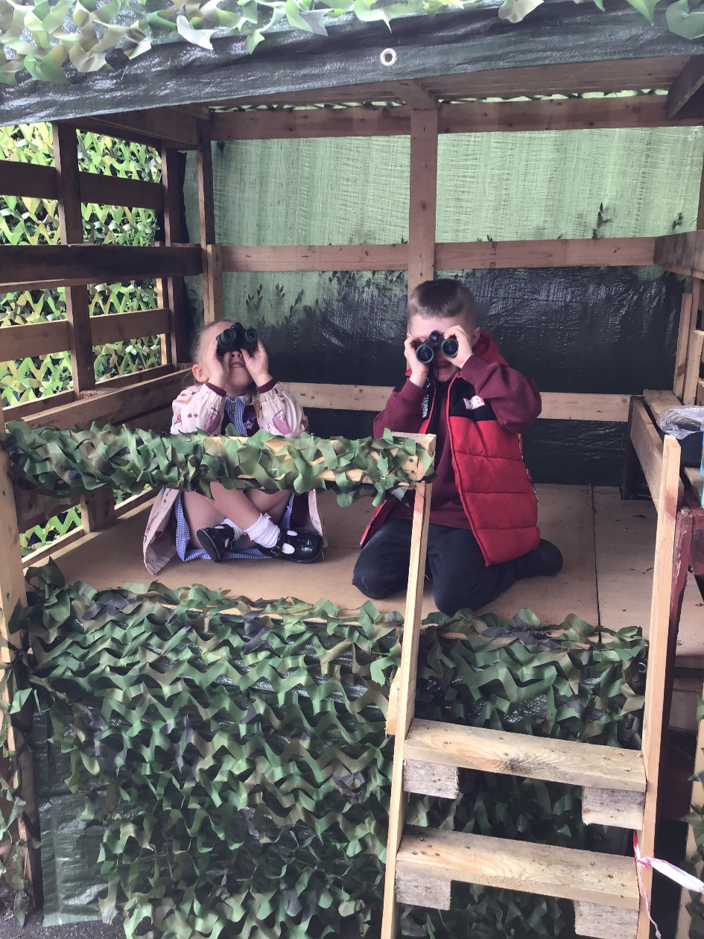
Our Play Team
Miss Hines
Mr Little
Mrs Breen
Mr Thornton
Leanne
Amy
Claire

Slide 3
What is play?

Slide 4


Slide 5
What are we aiming for?
https://www.youtube.com/watch?v=I427pLSNRGQ

Slide 6
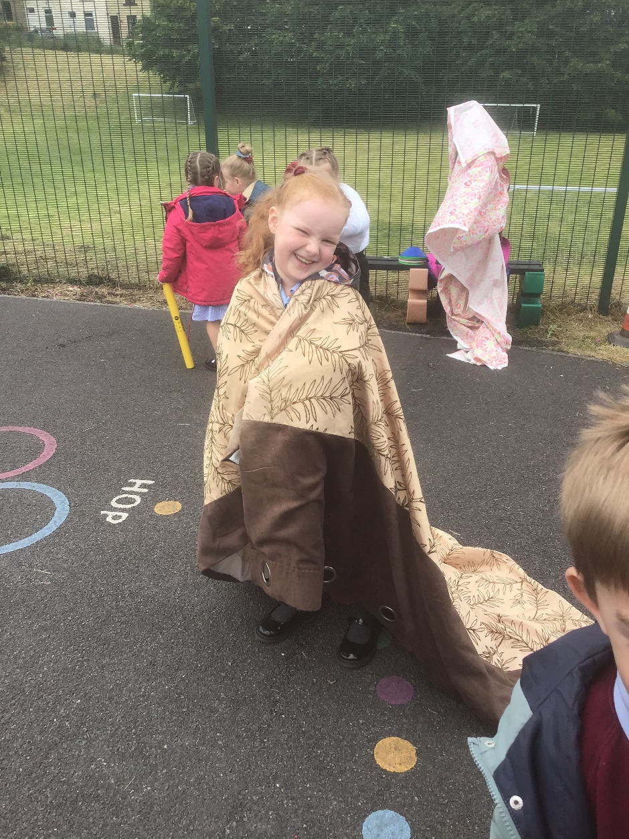
What do we have so far?
Tyres
Pots and Pans
Creative Resources
Dens
Role Play Box
Staging
Chalks
Music!

Slide 7
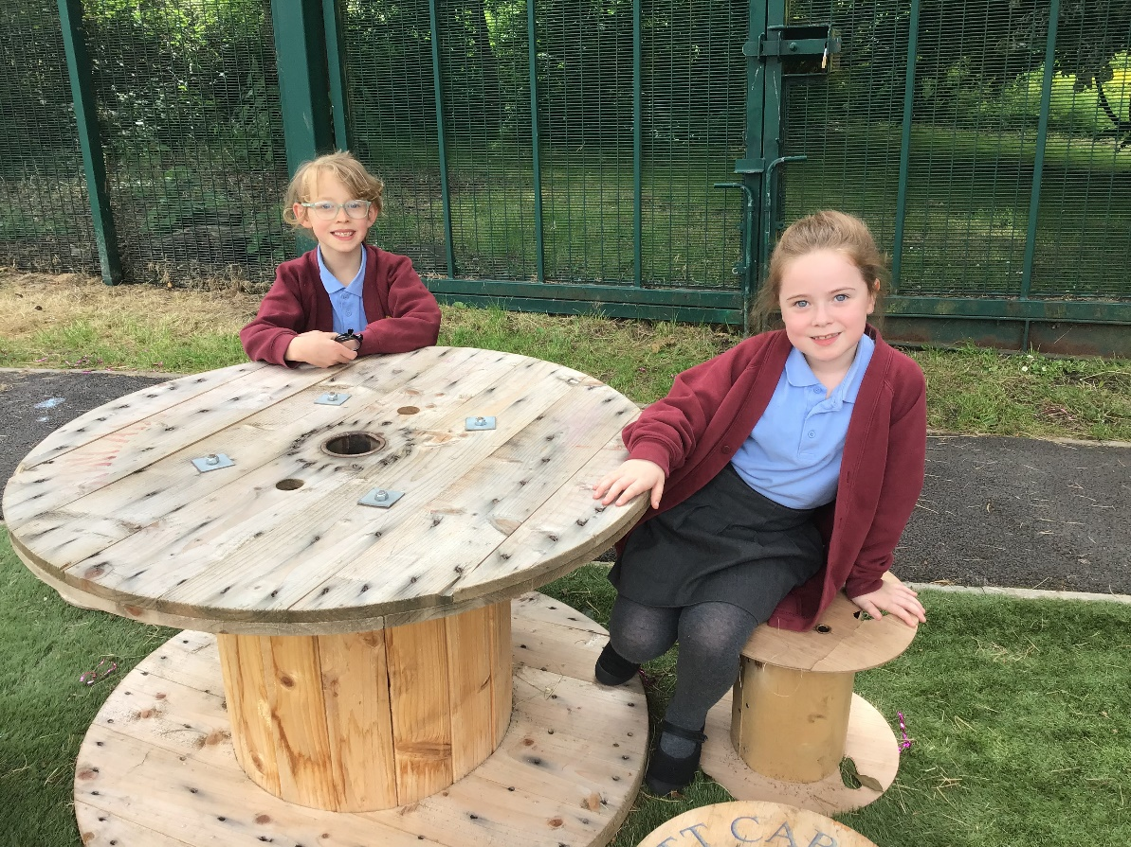
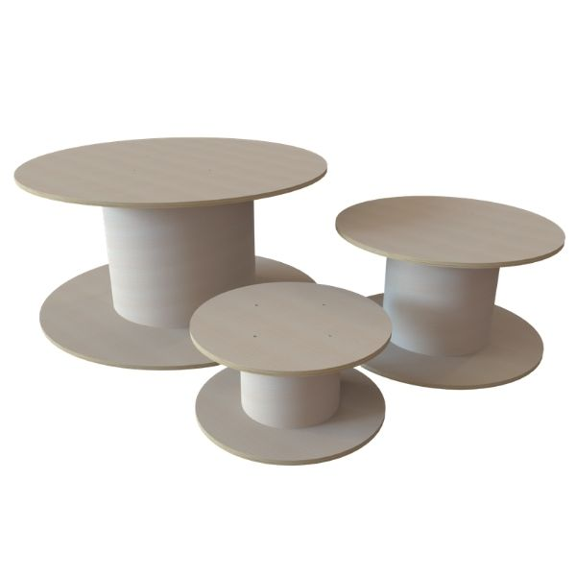
How do we use these safety?
Cable Reels – Smalls ones we sit, Big ones we can stand… apart from if it is acting like a table.

Slide 8
Tidying Up…
Tidy Up song
Help us make our rules for keeping Opal Play tidy.
What should our rules be?

Slide 9
Everyone’s responsibility…
At Holy Trinity everyone…
has the right to play.
shares equipment fairly and shows respect to others.
is kind and considers others’ feelings.
plays safely.
helps others and allows everyone to join in.
asks for help from an adult if they need it.

Slide 10
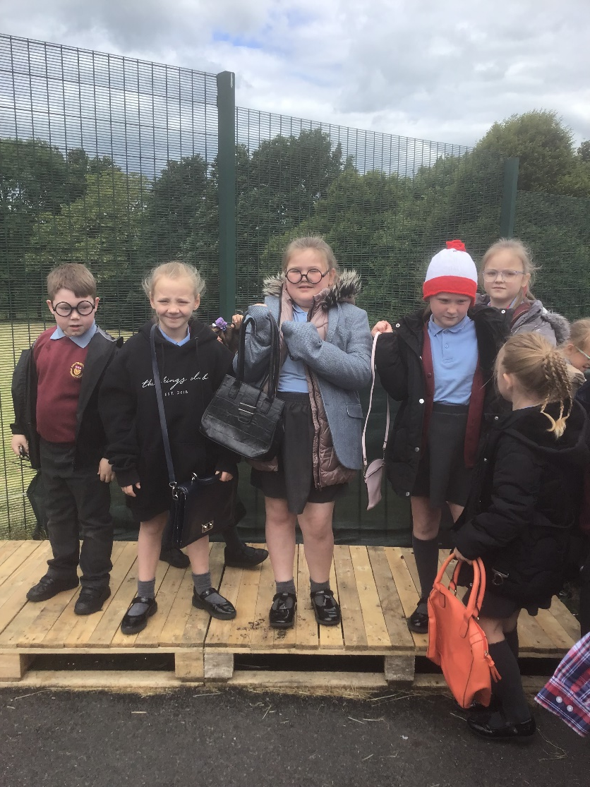
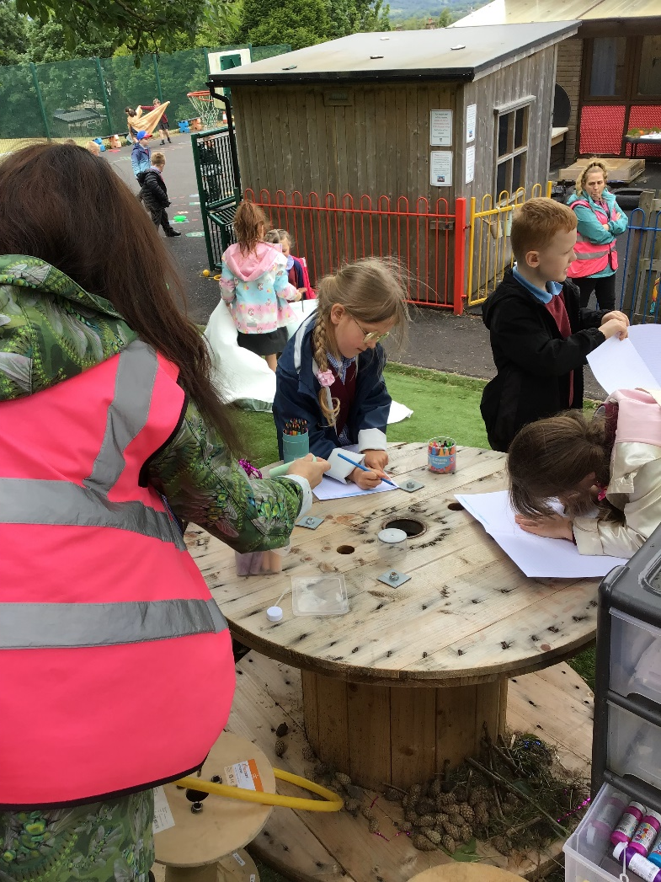
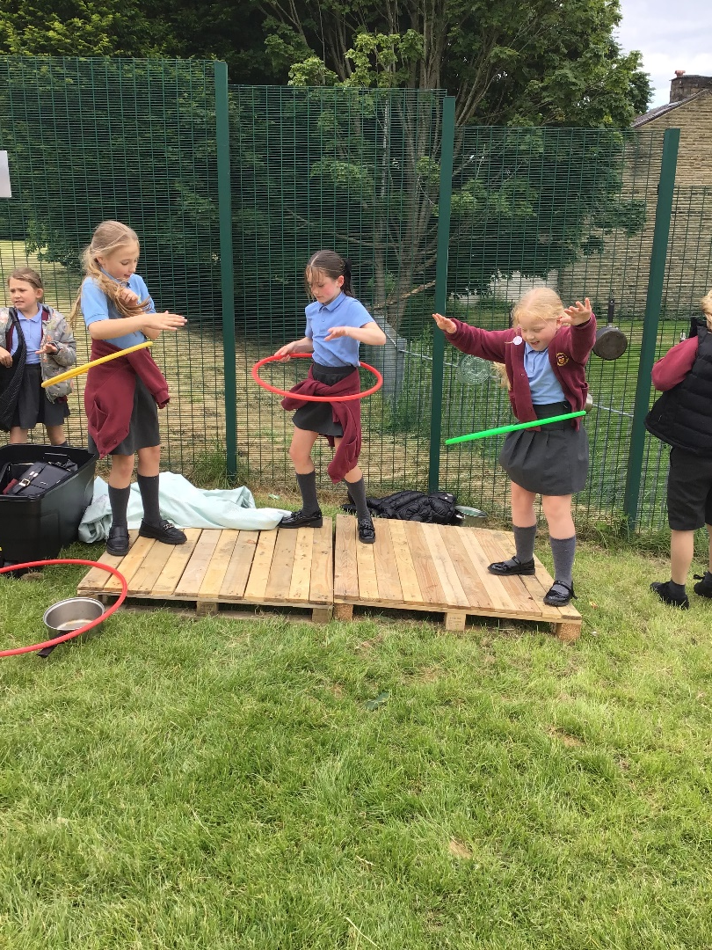
Some Amazing Play!

Slide 11
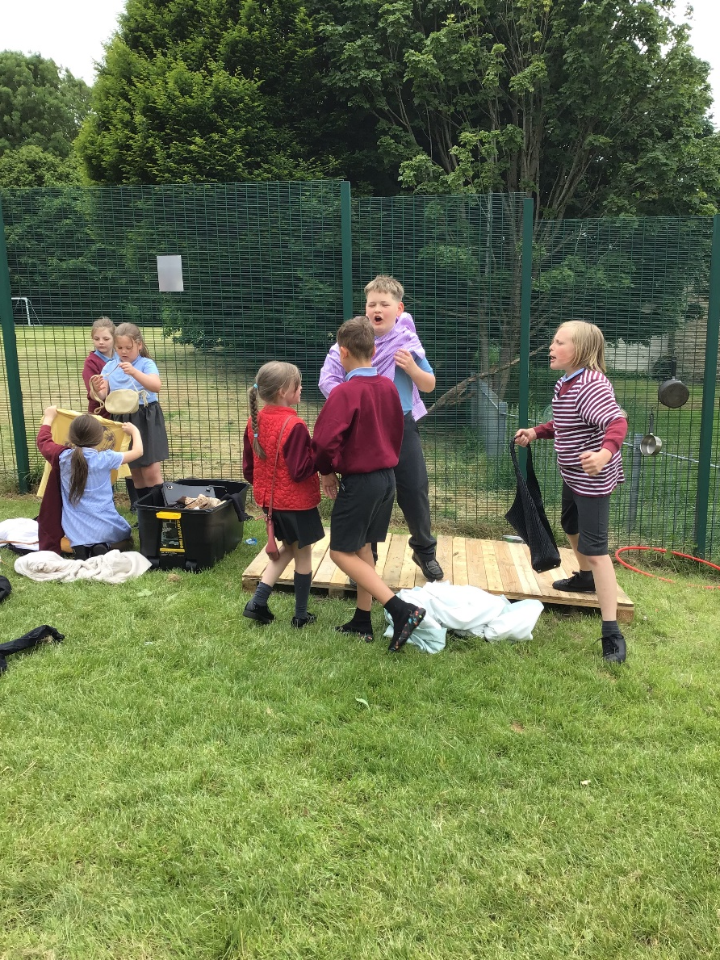
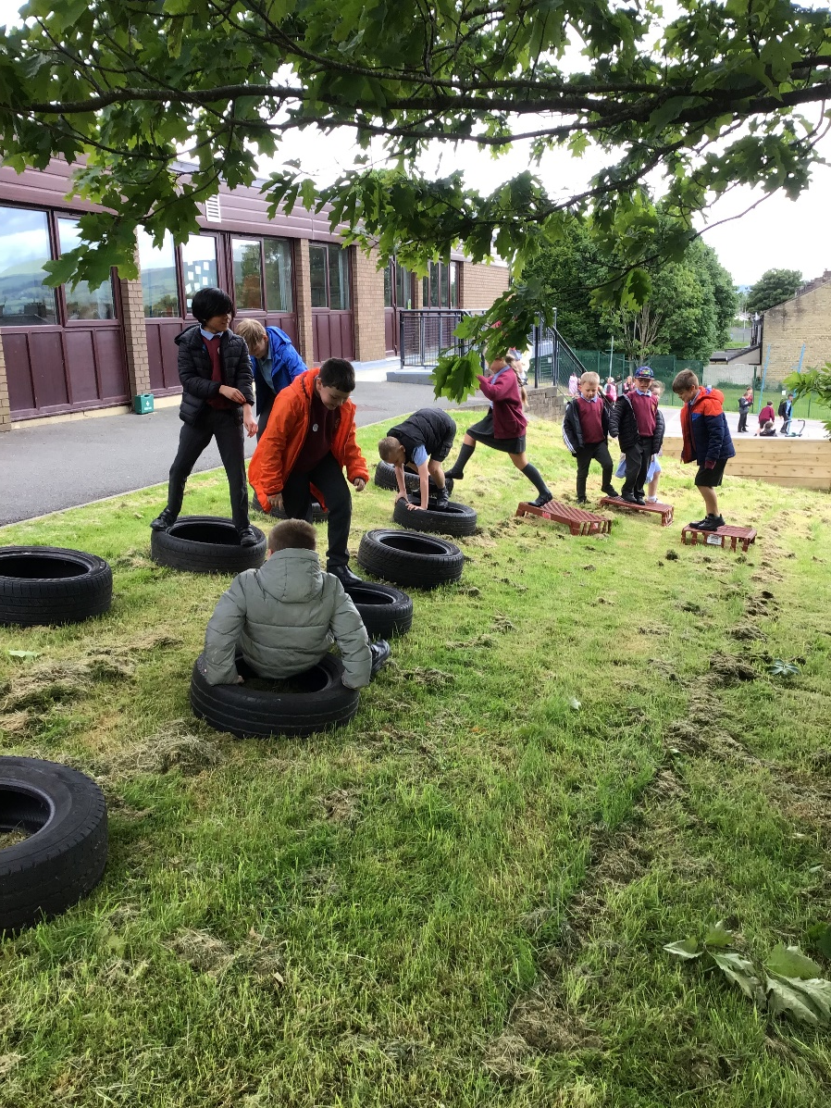
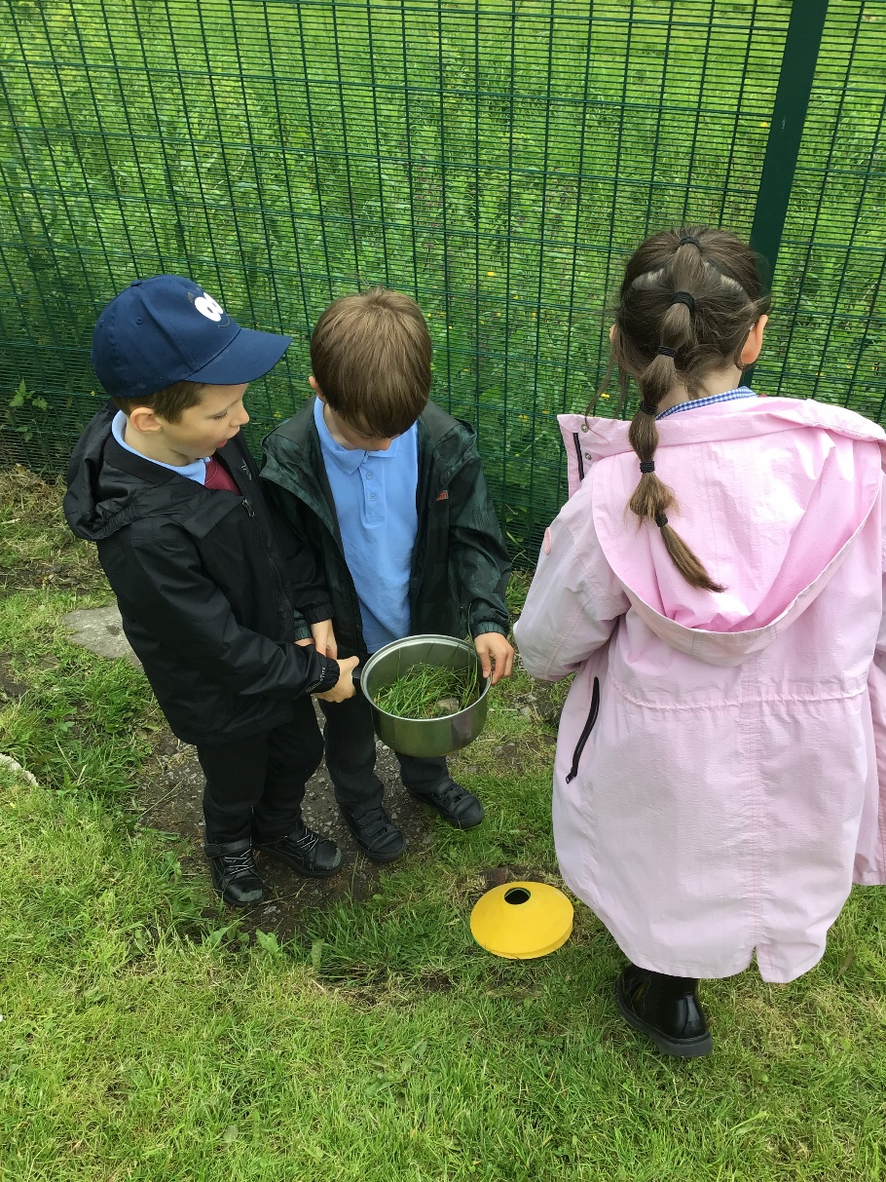

Slide 12
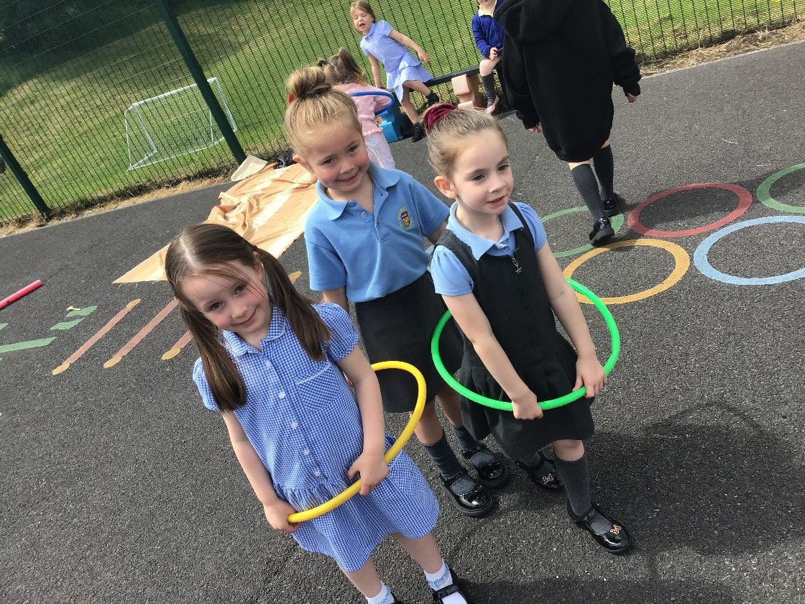
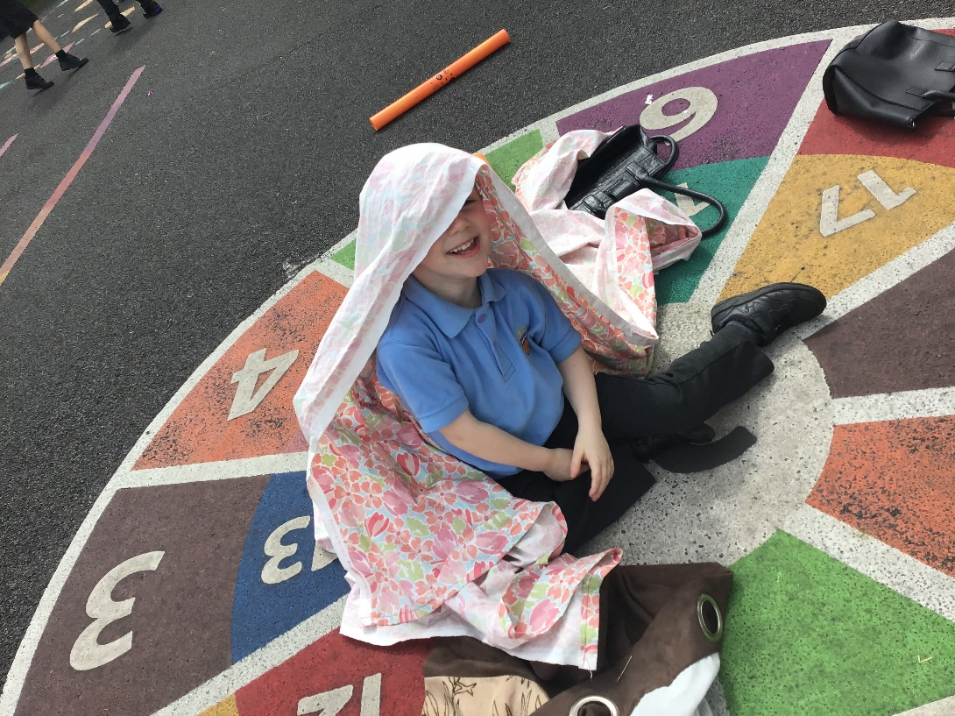
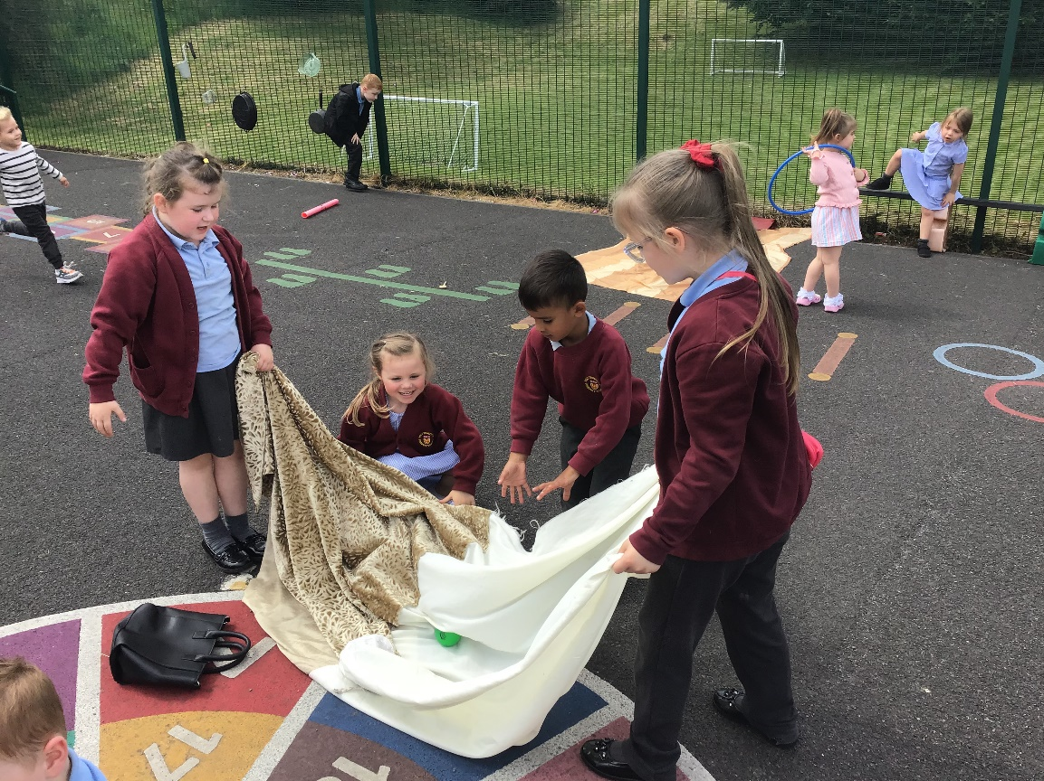

Slide 13
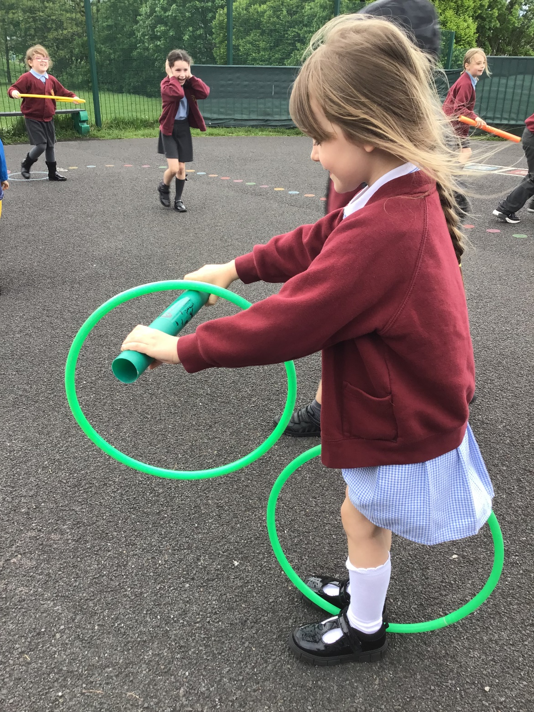
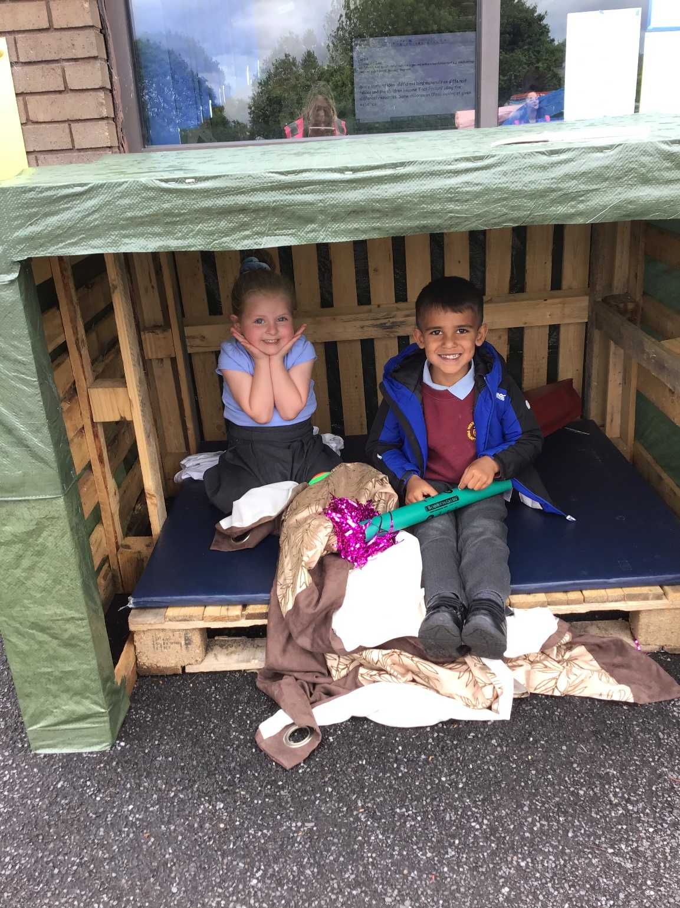

Slide 14

OPAL AWARDS
OPAL PLAY CHAMPION
OPAL TIDY UP HERO

