Slide 1

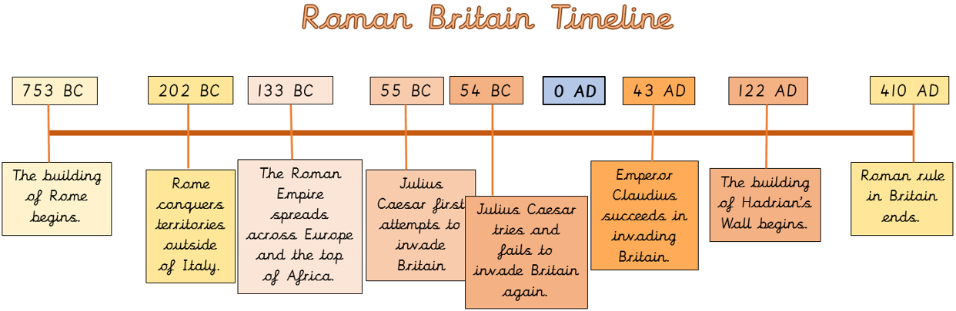





Substantive Concept: Migration
Disciplinary Concept: Consequence
Holy Trinity C of E Primary School- History Knowledge Organisers – Year 4
What effects did the Roman invasion have on Boudica and the Iceni tribe?
British Value-
Mutual Respect and Tolerance
What should I already know?
Timeline: 753BC – 410AD
In year 2 we learnt that, Florence Nightingale was a significant person because she was the founder of modern nursing, making hospitals safe and hygienic migrating to various places throughout her life.
In year 3 we learnt that, early civilisations were built on a river for food, trade and keeping clean.
Key Vocabulary:
Boudica | A Queen of the Ancient British Iceni tribe.
The Iceni Tribe | Ancient tribe of Eastern Britain.
Revolt | take violent action against an established government or ruler; rebel
Settled | Make ones permanent home somewhere.
Migration | Moving from one place to another.
Invasion | The movement of an army into a region, usually in a hostile attack that’s part of a war or conflict.
Consequence | Comes after or as a result of something you do.
Ruled | Exercise ultimate power or authority over (an area and its people).
Sentence builders:
The Romans were known for… One of the most important things the Romans did was… In Roman times, people lived… The Romans were skilled in… After conquering a new land… Life in Roman Britain was… This meant that… Therefore… After the battle, Boudica is said to have… Boudica’s army also destroyed… Boudica decided to lead a revolt against the Romans because… | Prior Learning Substantive Concept (First order): Equality EYFS: People who help us Disciplinary (Second Order) Concept: Significance Year 1- Neil Armstrong
Sticky Learning:
Boudica was a queen of the British Celtic Iceni Tribe who led an uprising against the occupying forces of the Roman Empire. | Between 60-61AD, Boudica led a revolt against the Romans. Tribes marched to Colchester which was the capital of Roman Britain and defeated the Roman Legion there. | Romans invaded Britain in 43AD they then settled and ruled the country for 400 years until 410AD. | The Celts fought among themselves so much and as a consequence were unable to work together against the Romans. | There was widespread migration of the Roman Empire across Britain.

