Slide 1

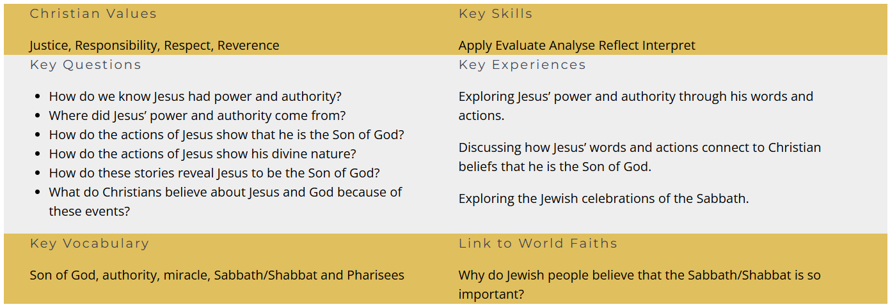
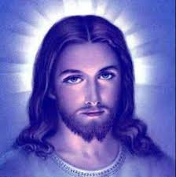


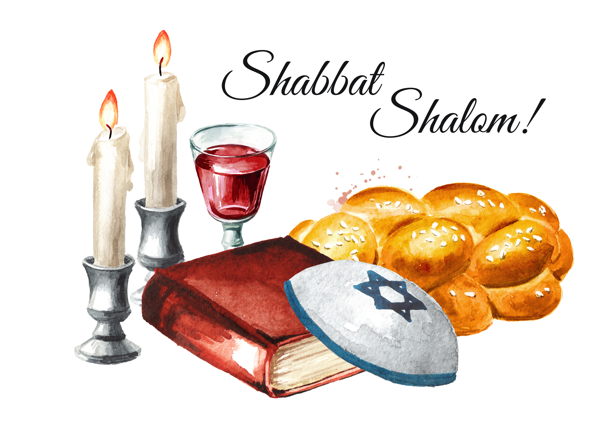
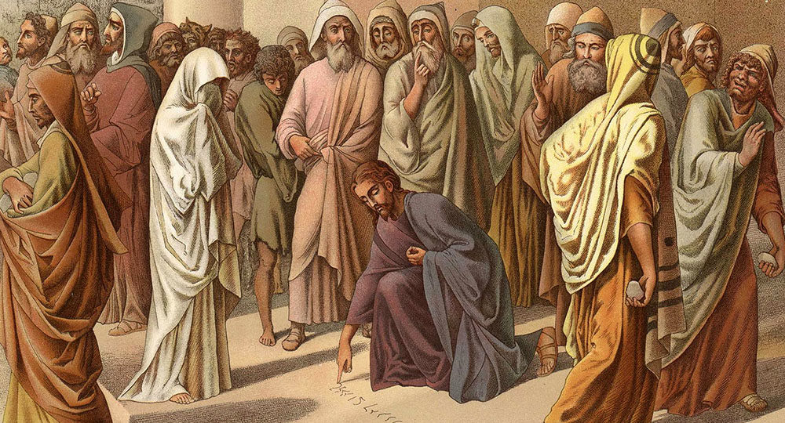
Holy Trinity C of E Primary School- RE Knowledge Organiser
Year 4
R.E.
Unit 4.3: Why do Christians believe Jesus is the son of God?
Big Question: Why do we dream?
Christian Concepts:
God- Creation- Fall- People of God- INCARNATION- GOSPEL- SALVATION- Kingdom of God
 | Son of God | Jesus.
 | authority | The power or right to give orders, make decisions and enforce obedience.
 | miracle | an extraordinary and welcome event that is not explicable by natural or scientific laws and is therefore attributed to a divine agency.
 | Shabbath/Shabbat | Judaism's weekly day of rest running from Friday sunset to Saturday nightfall.
 | Pharisees | A member of an ancient Jewish group.

