Slide 1






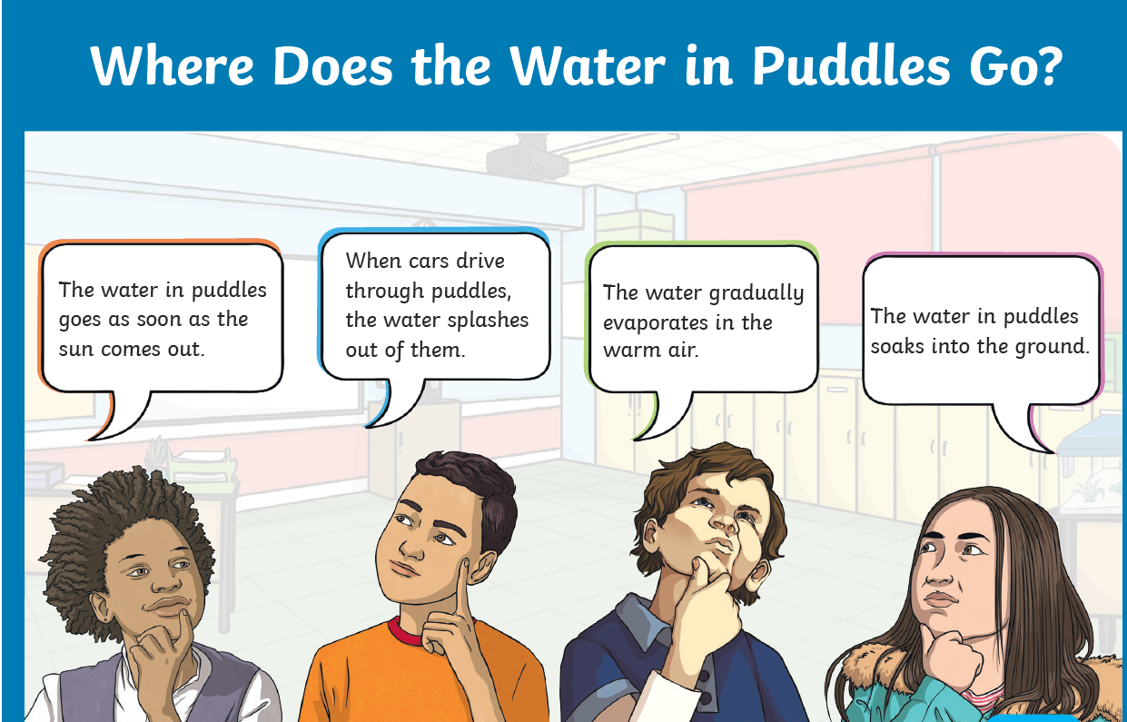
Holy Trinity C of E Primary School- Science Knowledge Organiser – Year 4
Topic: States of Matter
Scientific Enquiry:
What should I already know?
In year 2, you will have learnt, and be able to name and identify everyday materials including wood, plastic, metal, glass and water. You would also be able to describe their simple properties such as hard/soft, stretchy/stiff and smooth/rough. You should also, know that some materials change shape. In year 3, you would have group materials and know that objects/materials can be changed when heated and cooled.
Concept Cartoon:
Sentence Builders:
Materials can be either _____,______ or _______. The three states of matter are_______. Solids keep their shape because_______. A liquid can____ and _____. An example of a gas is____. When a solid is heated, it ____. A liquid is similar to a gas because____. I found out that______. This shows that________.
Key Vocabulary:
Solid | firm and stable in shape; not liquid or fluid
Liquid | a substance that flows freely but is of constant volume, having a consistency like that of water or oil.
Gas | a substance or matter in a state in which it will expand freely to fill the whole of a container, having no fixed shape (unlike a solid).
Shape | give a particular shape or form to.
Volume | the amount of space that a substance or object occupies, or that is enclosed within a container.
Freeze | turn or be turned into ice or another solid as a result of extreme cold.
Solidify | make or become hard or solid.
Melt | make or become liquefied by heat.
Sticky Learning:
The three states of matter are solid, liquid and gas. | We know something is a solid because it holds its shape. | We know something is a gas because it escapes from an unsealed container. | Water can change from a solid to a liquid by melting/heating. | We know something is a liquid because it forms a pool not a pile.

Slide 2


