Slide 1

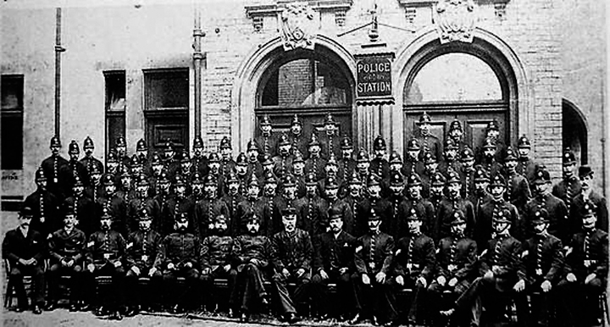
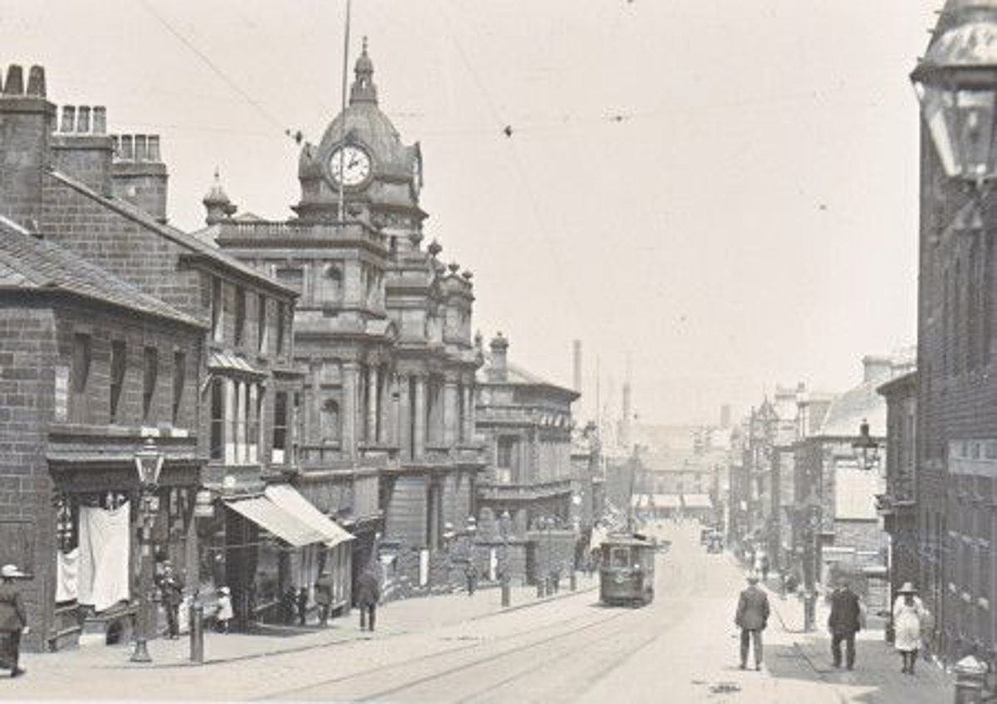
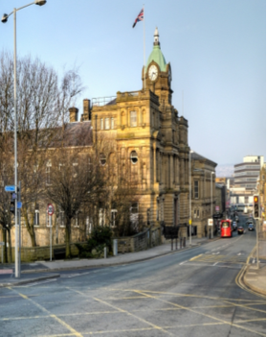
Substantive Concept: Justice and Equality
Disciplinary Concept: Sources and Evidence.
Holy Trinity C of E Primary School- History Knowledge Organisers – Year 4
What role did Burnley Town Hall play in local justice?
British Value-
Democracy and The Rule of Law.
What should I already know?
Burnley Town Hall and Police station over the Years:
In year 1, you learnt all about how Towneley Hall has changed over the past 120 years looking at different sources and evidence.
In year 3, you learnt all about the History of Scott Park and looked at how it has improved the lives of people in Burnley.
Key Vocabulary:
Mayor | The head of a town, borough or county council.
Councillor | A member of a council.
Crank | A type of punishments that prisoners would have to turn multiple times a day.
Artefacts | an object made or modified by a human being, typically one of cultural or historical interest.
Town Hall | a building used for the administration of local government.
Commemorate | recall and show respect for (someone or something).
Chronology | the arrangement of events or dates in the order of their occurrence.
Sources | Evidence taken from the past these can be primary or secondary.
Sentence builders:
In the past Burnley Town Hall was important because it was where… Long ago, Burnley Town Hall helped keep law and order by… Burnley Town Hall was once a place where rules were made and… In the past, Burnley Police Station helped keep people safe by… In the past, people who broke the law were taken to… Many years ago, police officers at the station worked… This meant that… Therefore… In the past, Burnley Town Hall and the Police Station worked together to… Together, these buildings helped make sure that rules were followed and… | Prior Learning Substantive Concept (First order): Equality EYFS: People who help us Disciplinary (Second Order) Concept: Significance Year 1- Neil Armstrong
Sticky Learning:
Burnley Town Hall was built in 1888 and is a Grade II listed building. | The police station, together with the magistrates’ court, formed part of the Town Hall from 1888 to 1955 | In the Town Hall car park, is a stone bearing John Baron’s name. He was a cotton waste dealer of Old Finsley Mill in Finsleygate, Burnley and the Mayor at the time. | In 1888 the Town Hall gave access to the police station (which had 30 prison cells) and the magistrates’ court. | Much of the crime committed in the past, just like today, consisted of minor misdemeanours

