Slide 1

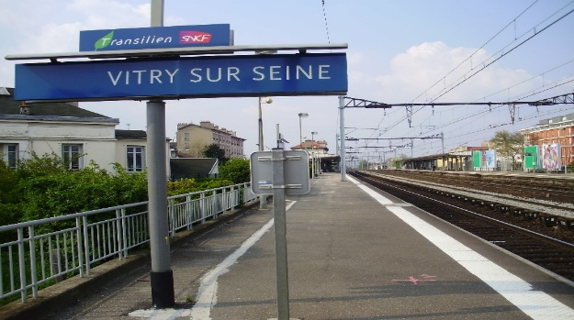
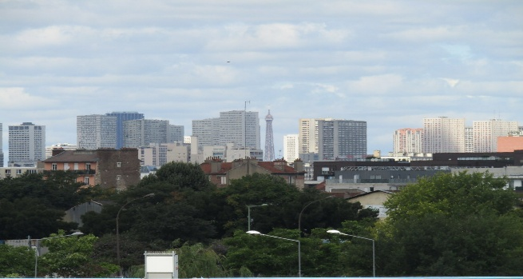
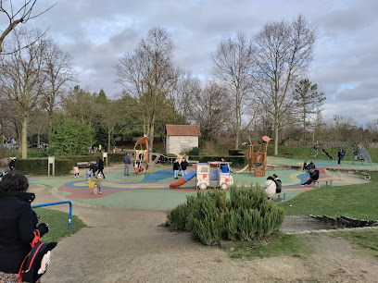
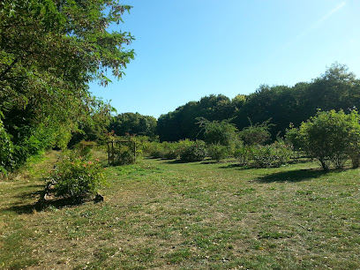
Burnley’s Twin Town Vitry—Sur—Seine
Holy Trinity C of E Primary School- Geography Knowledge Organiser – Year 4
What are the similarities and differences between Burnley and Vitry—Sur—Seine?
What should I already know?
Sentence Builders:
Both Vitry – Sur – Seine and Burnley share a History of… Like Vitry Sur – Seine Burnley is known for… Similar to the industrial background, Burnley is known for… Unlike Vitry Sur – Seine’s proximity to Paris, Burnley is located Compared to the Parisian suburb of Vitry-sur-Seine, Burnley is… While Vitry-sur-Seine is a suburb of Paris, Burnley is… Despite being industrial, Vitry-sur-Seine and Burnley differ significantly in…
Photos of Vitry – Sur - Seine:
In year 2 you learnt about the 7 continents and the 5 oceans of the world which will link into discovering all about the continent Europe most importantly France. Contrasting and comparing human and physical features.
Key Vocabulary:
Human features | geographical, man-made, or human-constructed elements placed on the Earth’s surface
Physical features | natural, non-man-made characteristics of the Earth's surface—such as mountains, rivers, and forests—that exist independently of human activity
Paris Basin | distinctive European core region with a population of 21 million stretching 500km. East to West and 300 km North to South
Industrial | economic activities that produce goods or services
Agricultural | the study of farming—cultivating soil, growing crops, and raising livestock—as a primary human activity that shapes landscapes, economies, and societies
Commercial | activities, land uses, and economic systems focused on the production, distribution, exchange, and sale of goods and services
Urban | a human settlement with high population density, extensive infrastructure, and built-up land use, typically featuring cities, towns, and suburbs
Rural | a geographic region located outside cities and towns, characterized by low population density, small settlements (villages, hamlets, or farms).
Sticky Learning:
The Seine River flows along Vitry-sur-Seine’s eastern border. | Map symbols for: Parking Telephone Bus Station Motorway Railway Station | Vitry-Sur-Seine is the twin town to Burnley and is located in the south eastern suburbs of Paris in France. | Vitry-sur-Seine’s is connected to Paris by rail (6 miles). | The region lies in the centre of the Paris Basin and consists of limestone plains.

