Slide 1

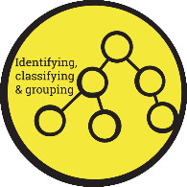



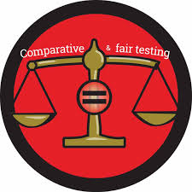
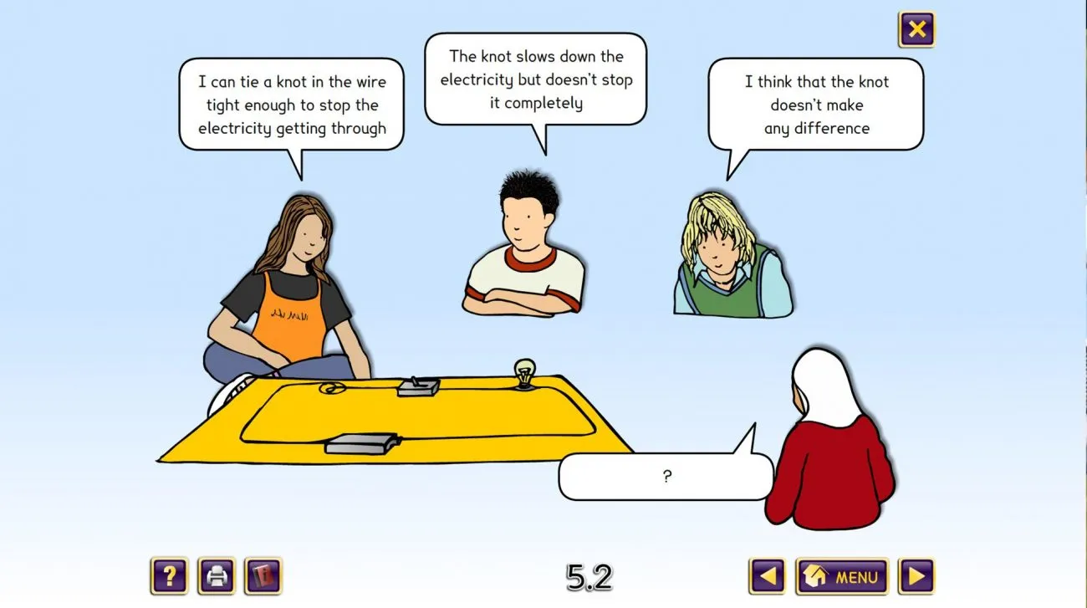
Holy Trinity C of E Primary School- Science Knowledge Organiser – Year 4
Topic: Electricity
Scientific Enquiry:
What should I already know?
In year 2 and 3 you should have already learnt that many devices use electricity to work. Electricity can be dangerous and should be used safely. Everyday appliances such as lamps, televisions, and toasters need electrical power. Some objects use mains electricity and others use batteries.
Concept Cartoon:
Sentence Builders:
I predict the bulb will/will not light because___________. Electricity can flow when_________. A simple circuit needs____ , _____ , and __________. I think _______is a conductor because______. I observed that________. Comparing the results I found that________.
Key Vocabulary:
Electricity | a form of energy created by the movement of tiny charged particles called electrons.
Circuit | a complete, closed loop or pathway that allows electricity (electric current) to flow from a power source, through various devices, and back again.
Conductor | A material that lets electricity, heat, or sound pass through it easily.
Insulator | a material or device that stops or slows down the flow of electricity, heat, or sound.
Component | an individual part, element, or substance that combines with other pieces to form a larger system or whole.
Buzzer | an electronic or electromechanical component that converts electrical energy into sound waves.
Positive | means an object or particle has more protons than electrons, or a deficit of electrons
Negative | means an object or particle has more electrons than protons, like an electron itself.
Sticky Learning:
Common appliances run on electricity e.g. toaster, kettle. To know which equipment uses most electricity and how to save usage. | Some appliances are battery powered e.g. laptops, phones. | Some common conductors and insulators, and associate metals with being good conductors. | Simple series electrical circuit consist of its basic parts, including cells, wires, bulbs, switches and buzzers. | Recognise that a switch opens and closes a circuit and associate this with whether or not a lamp lights in a simple series circuit.

Slide 2


