Slide 1


Welcome to Year 3
Meet the Teacher

Slide 2

Year 3 Staff Team
Class teacher Mrs Knight
Support Staff Miss Bury all day, Miss Mitchell am only.
PPA Cover (Monday pm and Tuesday last lesson.)
Mr Little PE
Mrs McNamara Computing and Spanish.

Slide 3


PE Days
PE will take place on Monday pm with Mr Little.
And on Wednesday pm with Mrs. Knight.

Slide 4
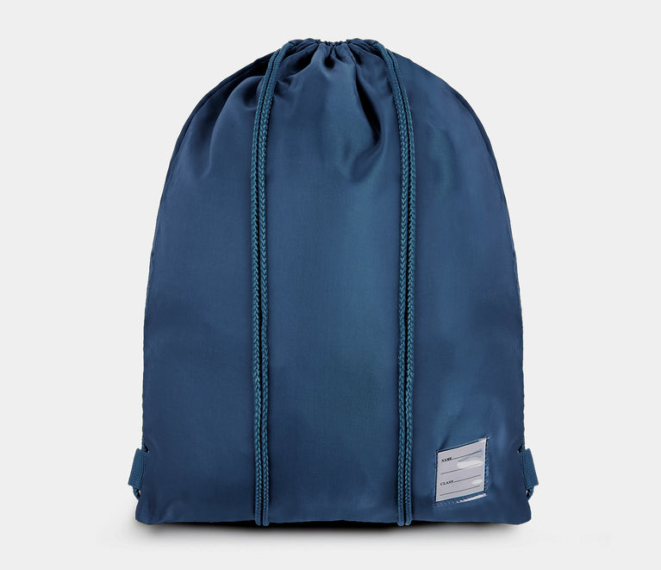
Please make sure PE kits are always in school as they may be needed on other occasions.
ALL jewellery must be removed for PE lessons. Earrings cannot be covered by plasters as these can become loose and fall off.
Please make sure all PE kit is clearly labelled with your child’s name so that any misplaced items can be returned.

Slide 5
Reading Books.
Reading books will be changed every Monday, Wednesday and Friday.
Please ensure you read at least 3 times per week with your child as a minimum. Ideally every night!
We do not expect you to finish a book every time especially as they get longer.

Slide 6



Home Reading Record.
Please sign or initial the home reading record every time you read with your child. Make a note of the page number so we know whether the book needs to be changed.
It is much better to read a few pages and talk about what you have read to check for understanding than to just read lots of pages.

Slide 7
Homework
Homework books will be given out on a Friday.
They can be handed back in at any time but must be back in school by Thursday for marking.
Please complete one item from the grid each week.
Spellings are taught in school and will not be part of our homework at this point.

Slide 8
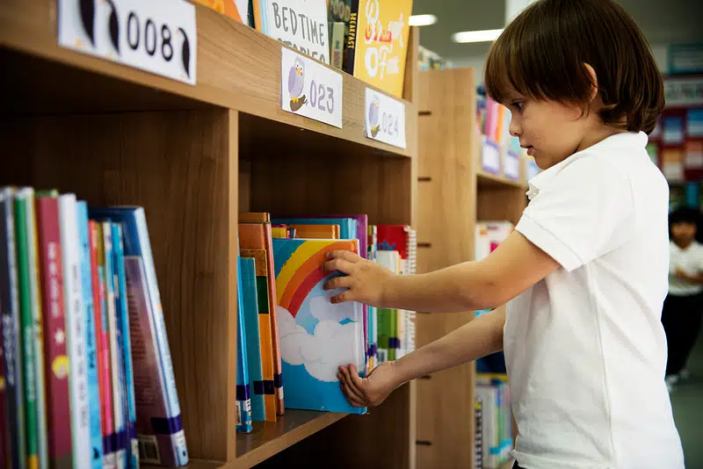
Library Books.
Our library session is on a Thursday and all children will have the chance to visit the library to choose a book to bring home and share. If you read this with your child instead of the school reading book, note this in the reading record as this still counts as reading!

Slide 9
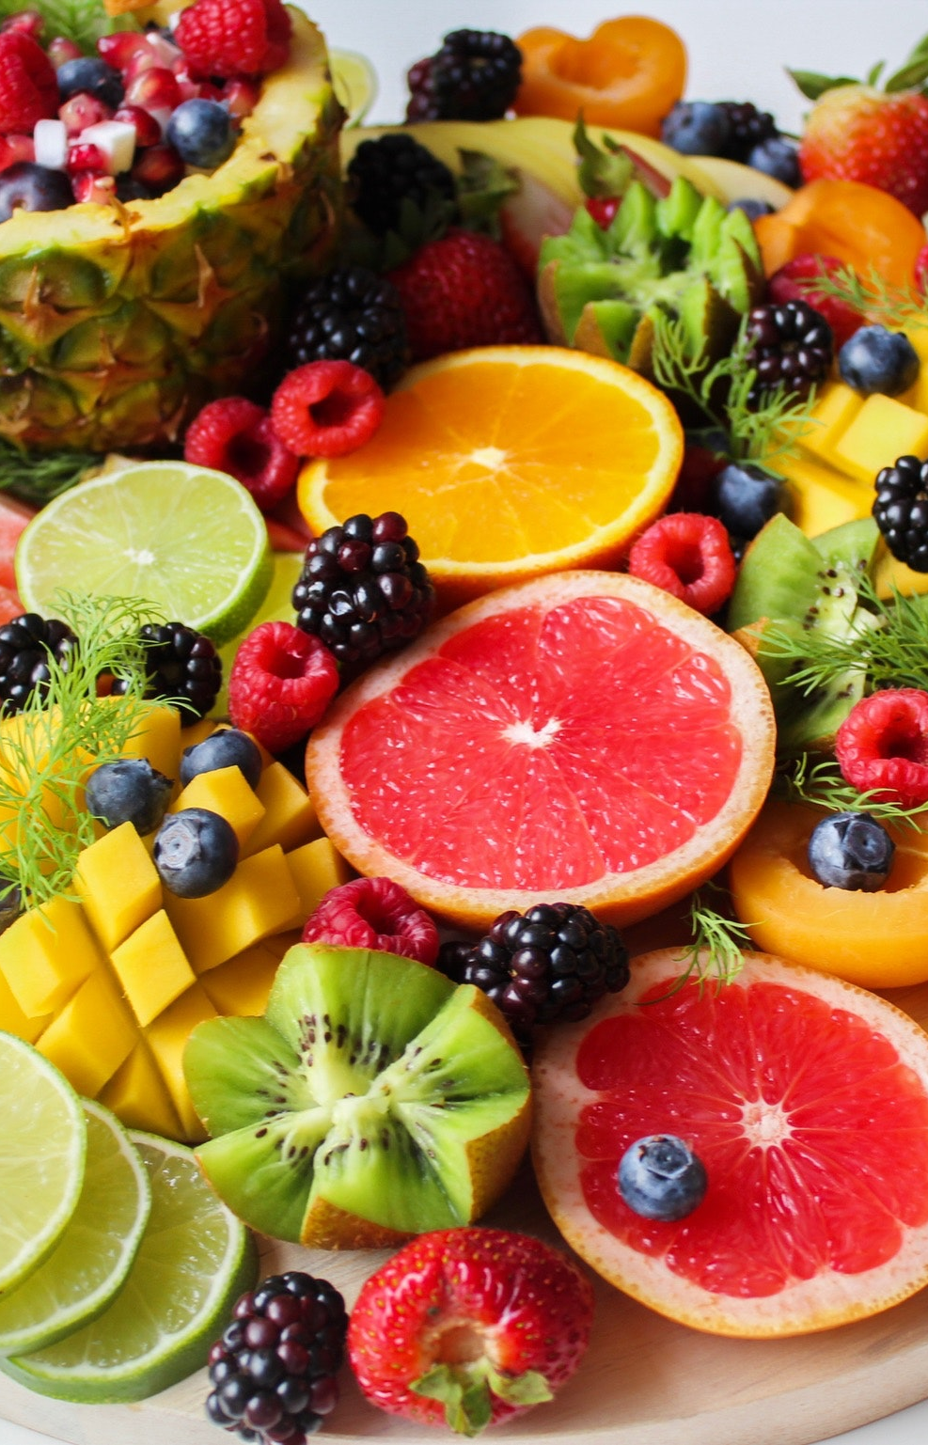
Snack for Break
Snack is no longer provided for your child. If you would like them to have a snack at morning break, please send in a piece of fruit with them.
Crisps, sweets or chocolate bars or biscuits are not allowed.

Slide 10

Any Questions
Please see the class webpage for up-to-date curriculum information.
Email me mrsknight@holytrinitycofe.lancs.sch.uk
I will do my best to respond between 8am and 4.30pm each day.

